Slide 1
Safe Dose
Drug Journal

Slide 2

Mission statement:
Help you recover your self

Slide 3
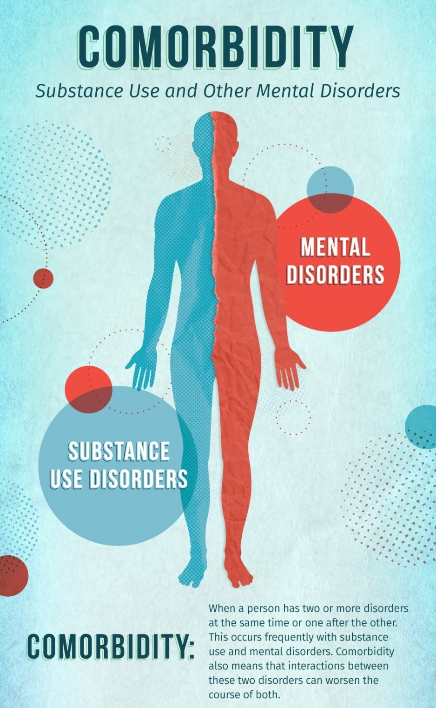
The problem
Comorbidity
Almost a third of adults in the European Union aged 15-64, or around 97 million people, have used illicit drugs at some point in their lives.
Chronic use of some drugs can lead to both short- and long-term changes in the brain, which can lead to mental health issues including paranoia, depression, anxiety, aggression, hallucinations, among others.

Slide 4
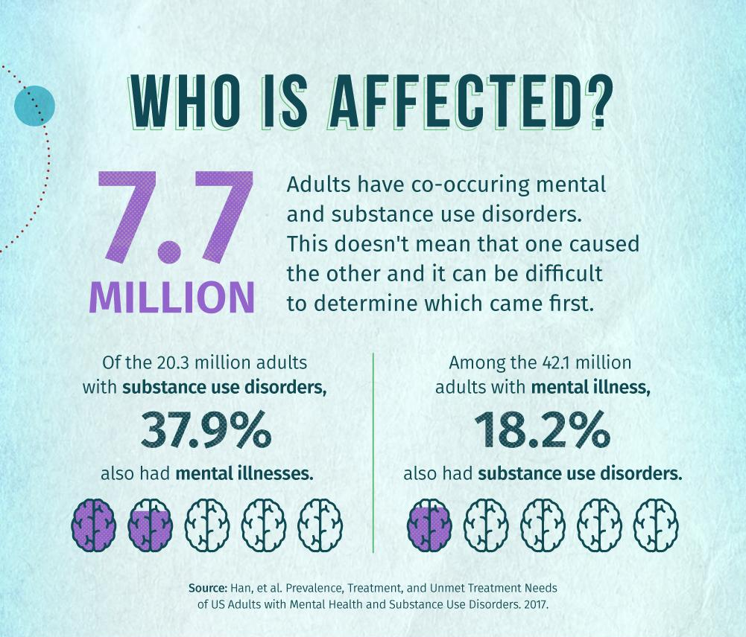
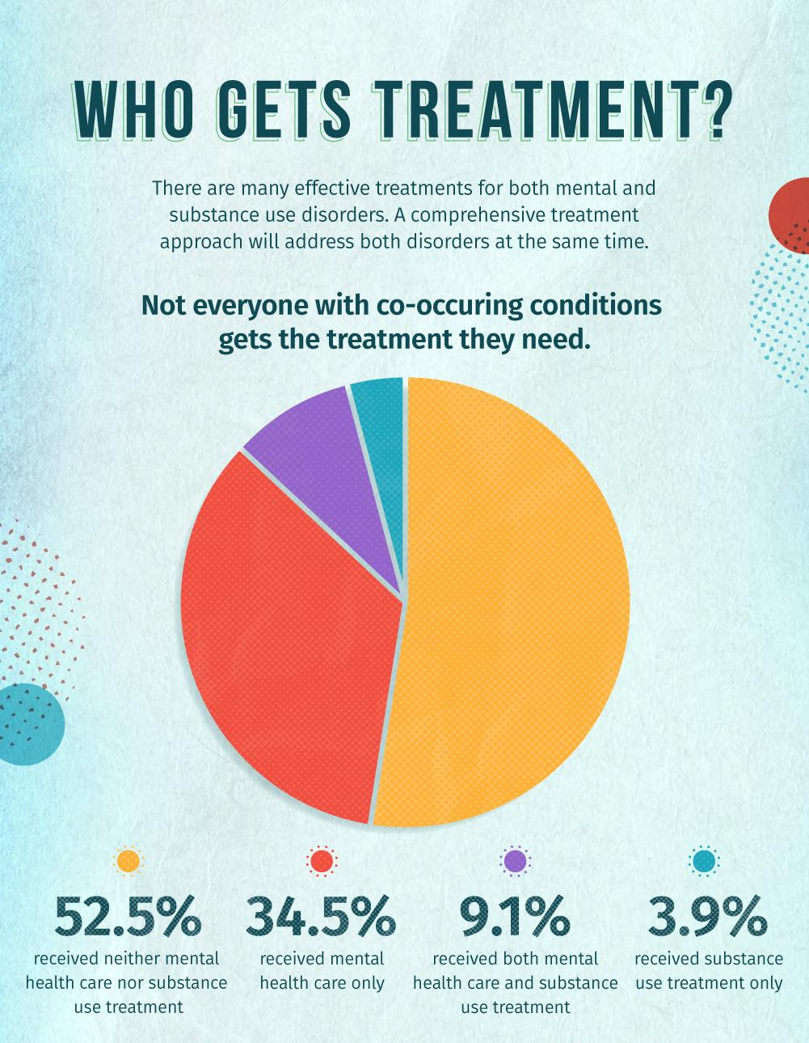
The Problem
Infographic by National Institute on Drug Abuse, “Comorbidity: Substance Use and Other Mental Disorders” (2018)

Slide 5

The product
A community in which users can trust to find information and help.

Slide 6
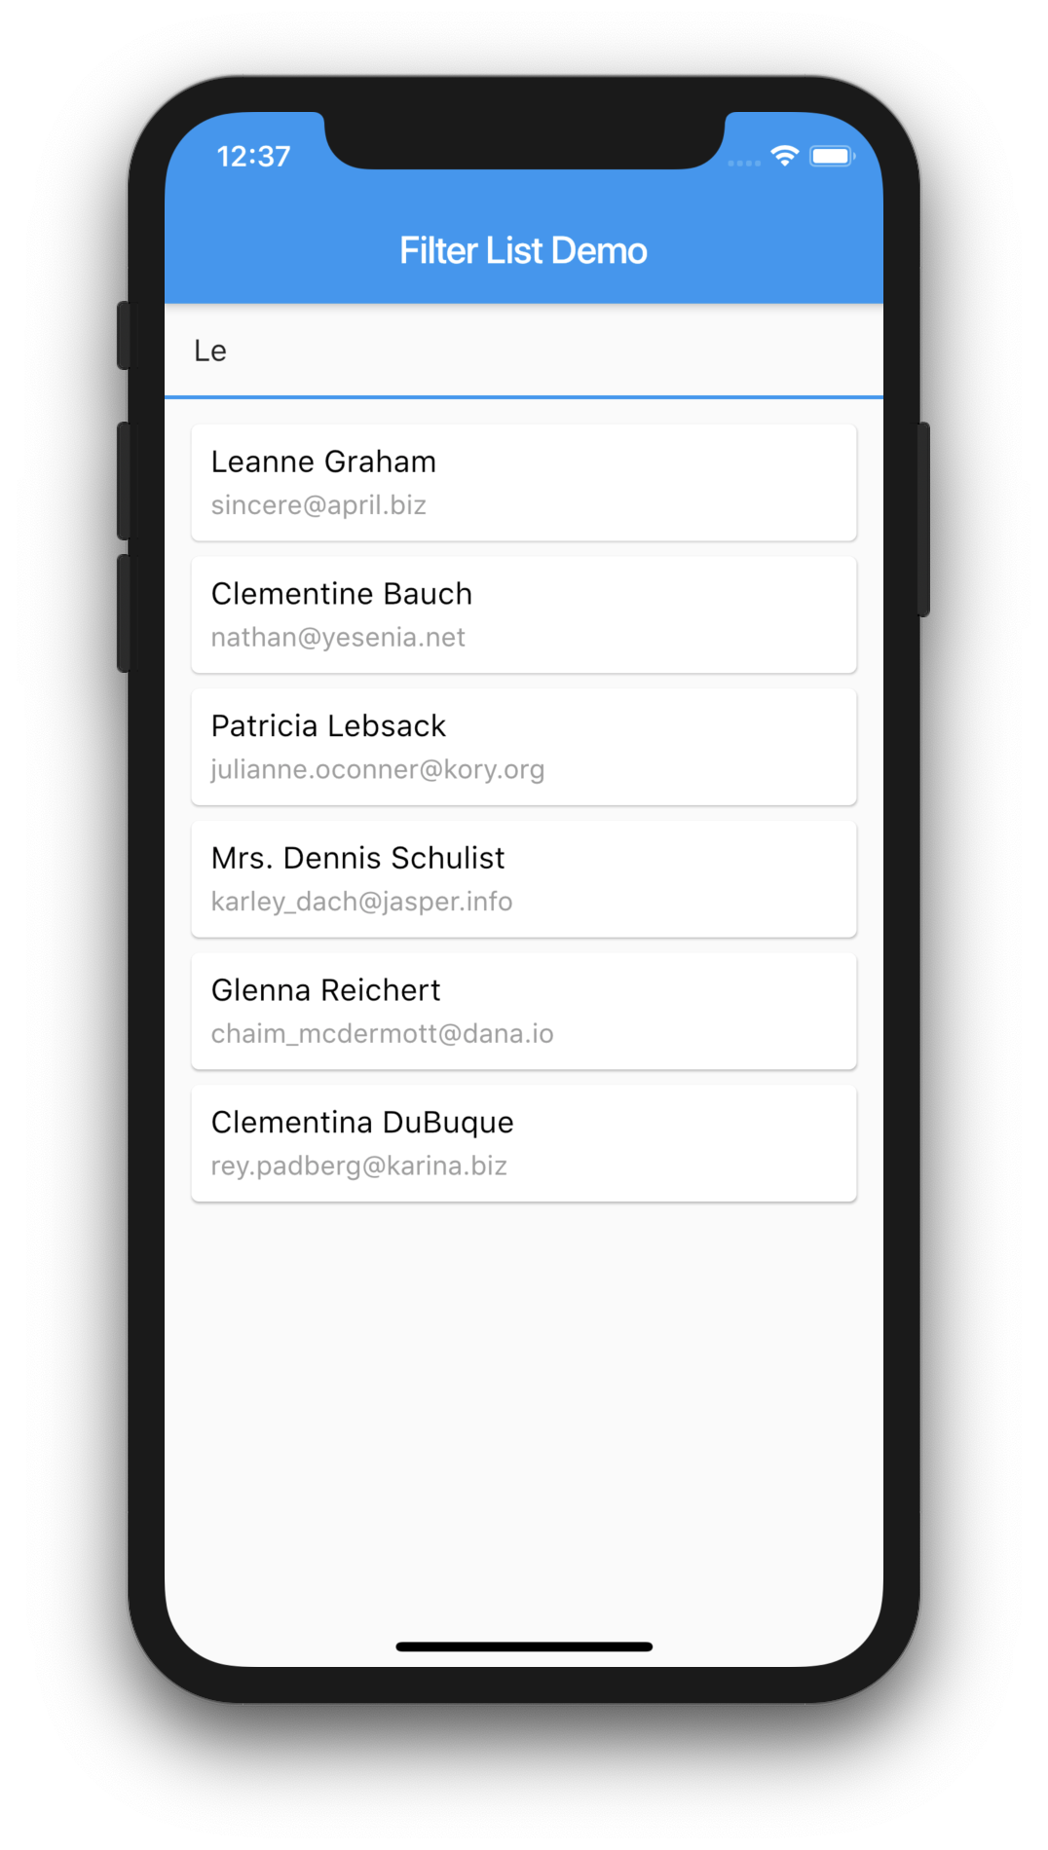
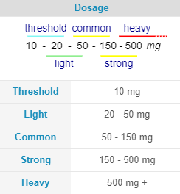
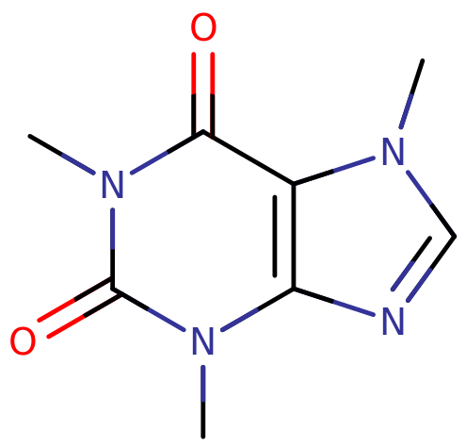
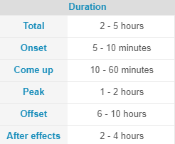
1. Search for the substance
Caffeine
Psychoactive class: Stimulants
When you select it, you will receive basic information about it
The Product

Slide 7
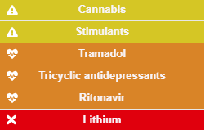
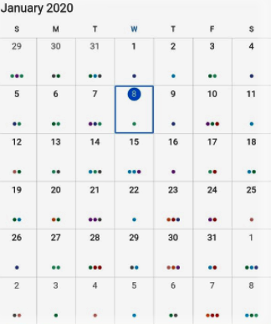
2. Choose the dose you are taking and it will be added to the calendar
Lysergic acid diethylamide (LSD)
Interactions
Psychoactive class: Psychedelic
Interactions
Harm potential
Tolerance
Physical effects
Visual effects
Cognitive effects
Multisensory effects
Cognitive Effects
Hallucinations
Psychosis
Anxiety
Thought loop
You will have information about dangerous interactions, as well as the subjectives effects and potential side effects
The Product

Slide 8
3. You will be reminded of the risks to which you are susceptible, and you will be given advices that might save your life
4. You will always have help available one click away
Call an Ambulance
If you feel discomfort on your chest or dizziness do not hesitate to look for help
Alcohol & Amphetamines
Physiological dangers:
Liver damage
Arrhythmia
Stroke
Heart attack
Psychological dangers:
Anxiety
Psychosis
Increased suicidal thoughts
Call mental health helpline
Suicidal ideation?
Total helplessness?
The Product

Slide 9
5. Depending on the frequency and dosage of the drug, the user will be classify into one of the 4 stages of addiction
If a user would like to come back to a previous stage they would have to cut down the frequency and dosage.
This is a hard process, so they will be offered advices on how to stay present and avoid cravings.
Professional help will be available. A user can maintain their anonymity if they wish to do so.
Stage 1 - Experimentation
To feel good — feeling of pleasure, “high” or "intoxication"
To feel better — relieve stress, forget problems, or feel numb
To do better — improve performance or thinking
Curiosity and peer pressure
Stage 2: Regular Use & Abuse
Something that was once considered recreational or temporary becomes a lifestyle. Users can suffer from exaggerated mood swings in between doses
Stage 3: Dependency & Tolerance
The brain stops releasing chemicals naturally, and instead relies on the outside substance to dictate the regulation.
Stage 4: Addiction
Impaired control — desire or failed attempts to cut down or control substance use
Social problems — failure to complete major tasks at work, school or home
Risky use — substance is used in risky settings
The Product

Slide 10
Milestones
Short term
May 2022
October 2021
January-April 2022
July 2022
Introduce ads and premium option
Launch minimum viable product
Jan | Feb | Mar | Apr | May | Jun | Jul | Aug | Sept | Oct | Nov | Dec
Open the app to experts on addiction who would like to offer their services
Add new features & Expand database of drugs and their interactions

Slide 11
Vision
Every human on Earth has dreams. Some of them have the courage to take a recurrent dream and make a plan to achieve it. Those are usually the ones who push our civilization forward.
Courage does not mean wisdom and life is not always easy. Sometimes temptations may lead us away from our path.
This project is founded to help people realign their habits with their purpose.

Slide 12
How it works
Step 3
Step 2
Step 1
Create a network where the community can share drug related information
Connect users with help whenever they need it
Increase awareness of:
Dangerous combinations
Real frequency of drug intake
Potential side effects

Slide 13
Revenue model
Free
Premium
Premium + Professional
The app will have all the basics features for free
It will show ads by default but users can pay a subscription to avoid them
Those who would like to go through a rehab process will have the help of experts at hand

Slide 14

Why now?
Today we are at the peak of psychoactive substances consumption in human history.
People with a genetic predisposition to suffer certain mental health issues have a significantly greater chance to develop the disorder

